Slide 1
Followup
Presentation
For TOUCH New York

Slide 2
Visual Mockups for Digital Recordkeeping System

Slide 3

Visual Mockups: Typeface and Color Palettes
The UI design will match the design of the TOUCH website by using the same colors and fonts.
The three colors at the top are all picked from the TOUCH logo. The blue and red at the top should never be used to distinguish between two important items because their brightness is the same. The bottom two colors are picked from the TOUCH website.
Roboto is the font currently being used everywhere on the TOUCH website. It is a clean and simple font designed by Google that is in use on hundreds of popular services and apps.
Roboto

Slide 4
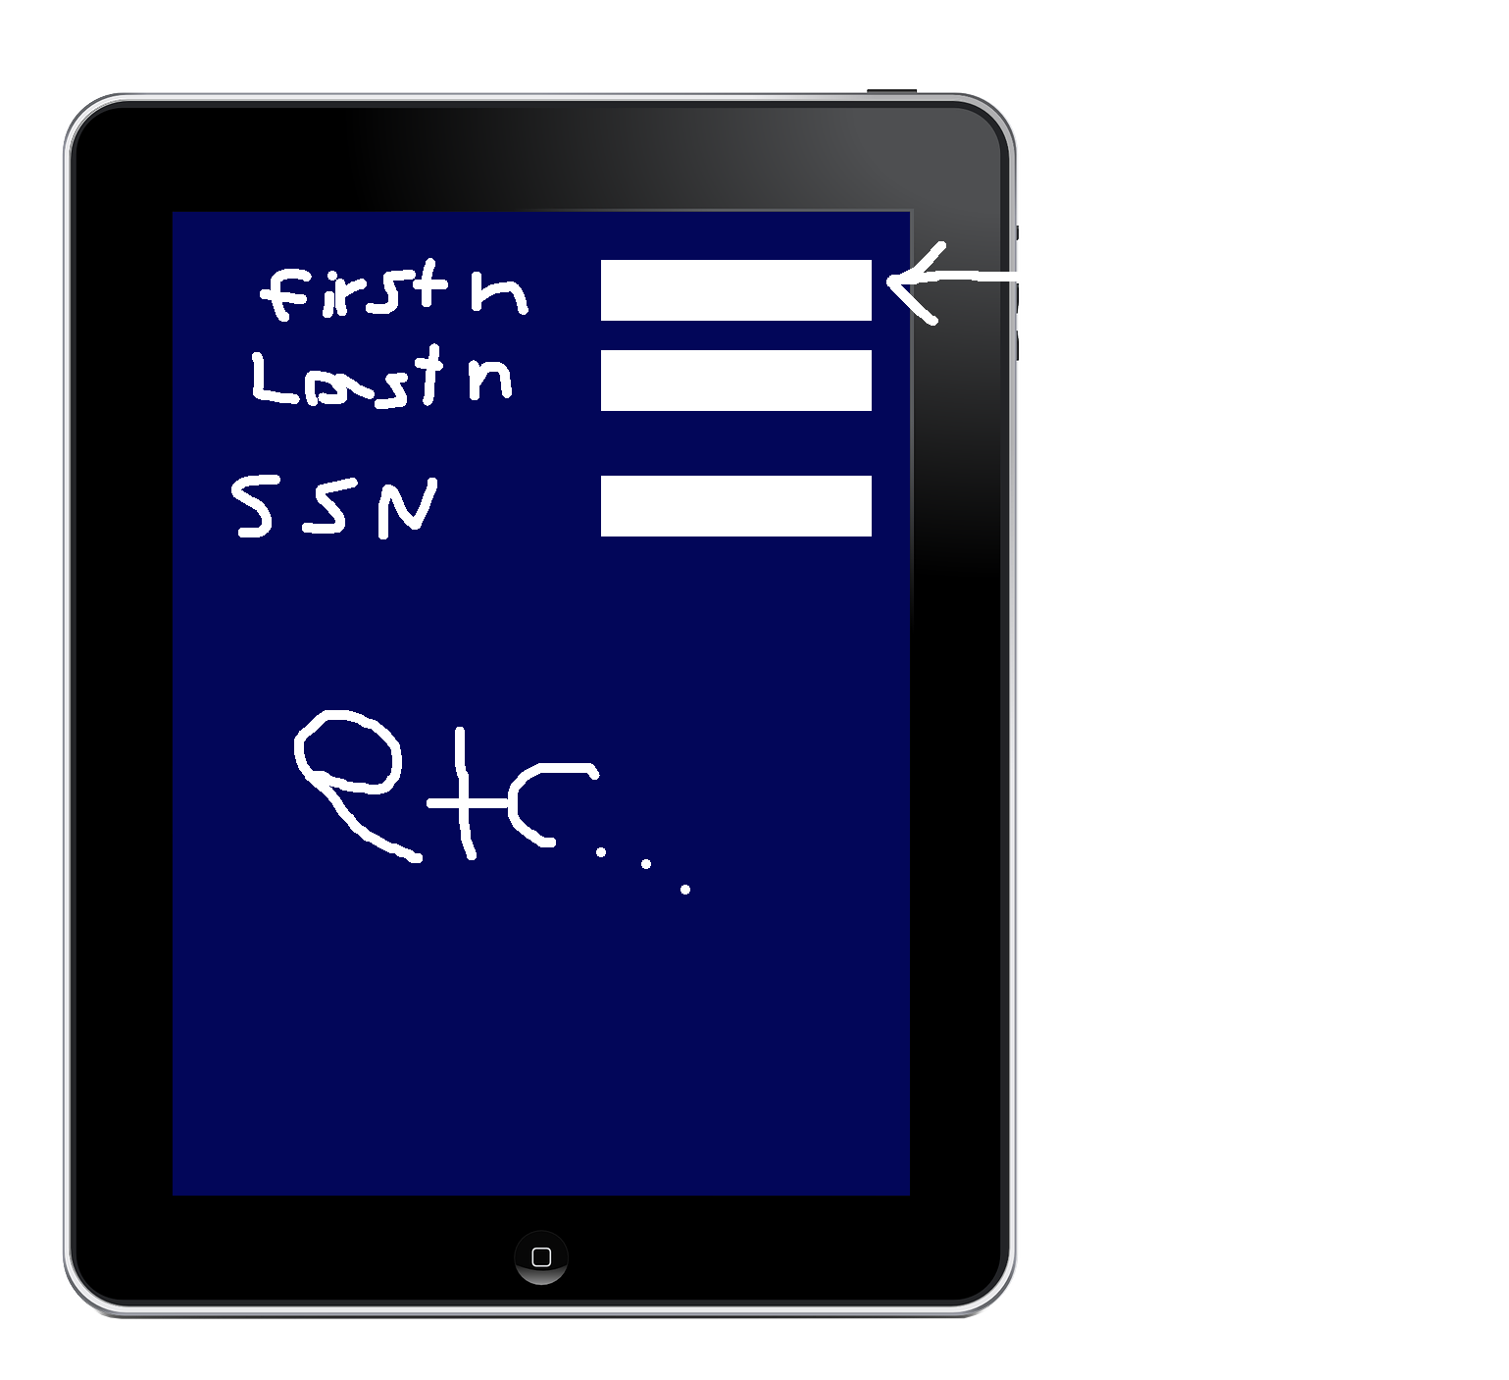
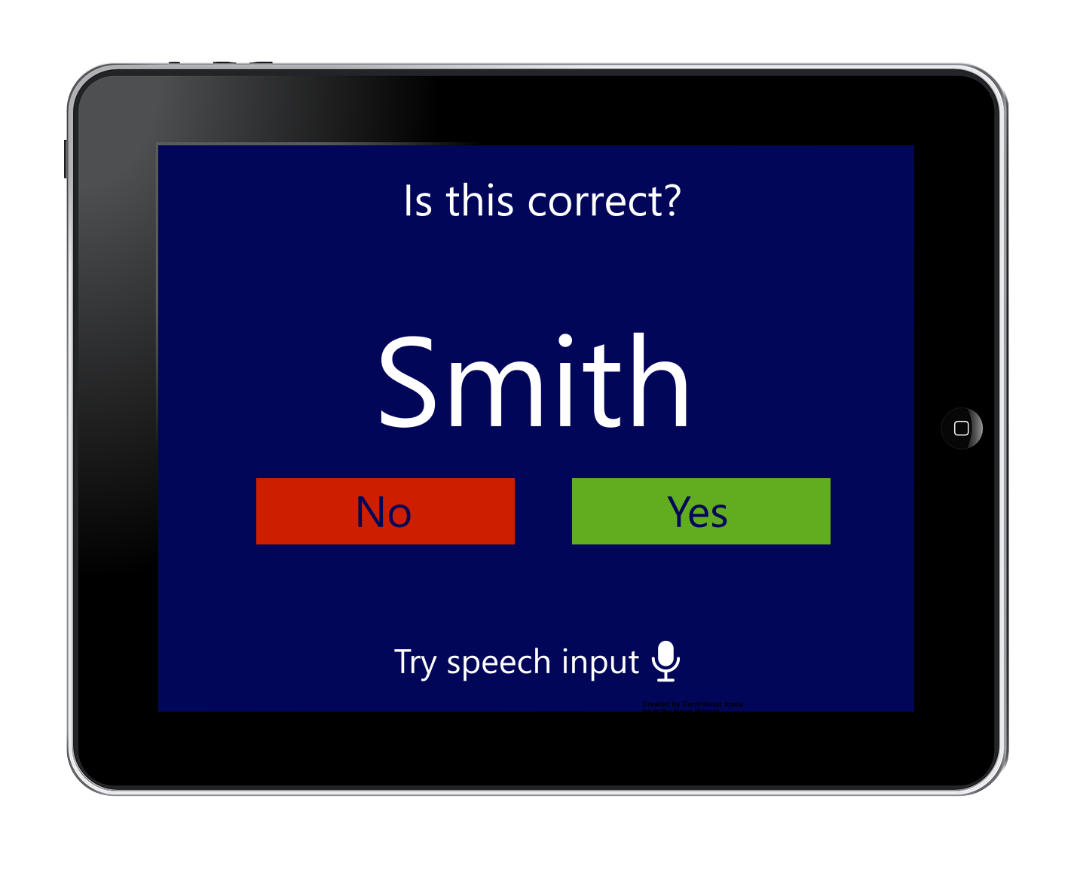
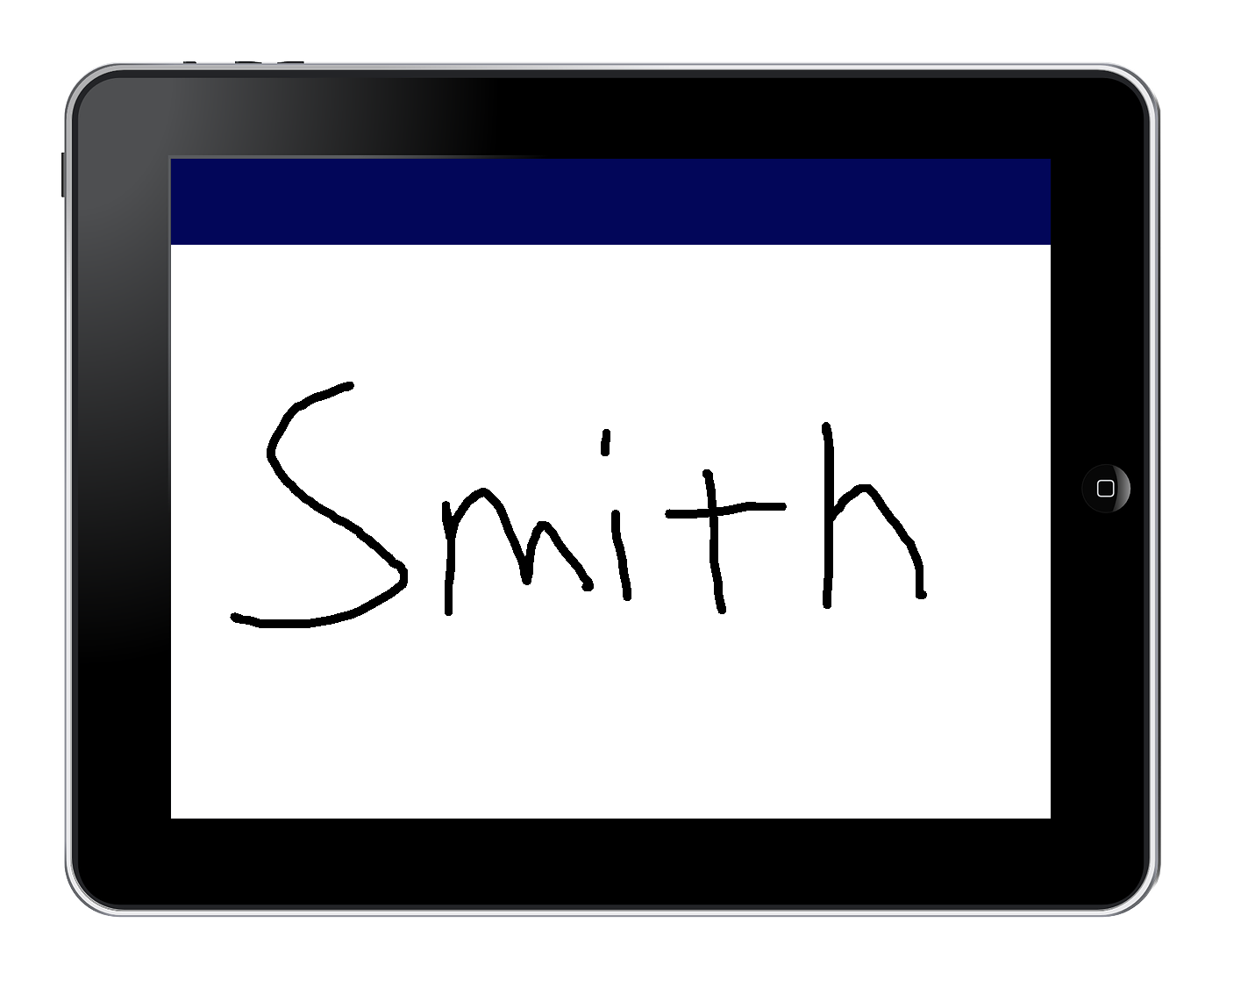
Visual Mockups: form interface
Please print your first name

Slide 5
A New Proposal: A Clean-Up of the Website
The previous two slides depicted mockups for a digital recordkeeping system because that is what my professor ordered me to create. However, I believe the best way to help TOUCH is to abandon the digital recordkeeping proposal. With the information I learned about the client last class (digital recordkeeping is already in-place, the client wishes to improve their digital public presence), I have realized that my previous proposal does not suit the client’s needs.
I would like to raise a different proposal that I thought of before: a “clean-up” of the TOUCH website. I do not think that the website needs an entire redesign or rebranding (the design is already quite strong), but there are a few pages with out-of-date information, and other small things. I have experience in web design and development, so I am more likely to be helpful with this proposal than the recordkeeping proposal (I have no experience with recordkeeping).

Slide 6
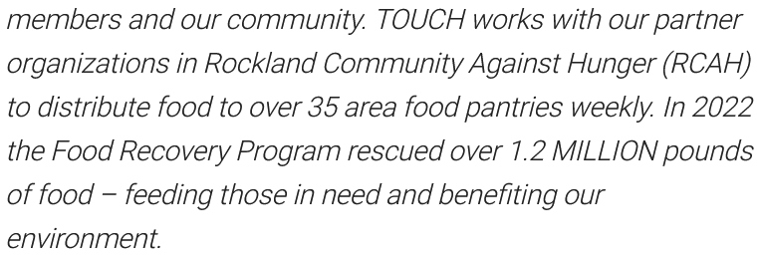


Examples of Things that can be Improved
The website could have more links when organizations and keywords are mentioned
A snippet from the homepage. The words circled in blue could be turned into links. RCAH could link to their home page. “Food Recovery Program” could link to the “Promoting Nutrition and Preventing Food Insecurity” section of the About Us page which explains what the program is.
The poster images on the “Fighting Hunger” page could be converted to sections that are a part of the page. This would make them easier to read, especially for users of screen readers (which are not compatible with text in images).

Slide 7
Thank you!

